Slide 1
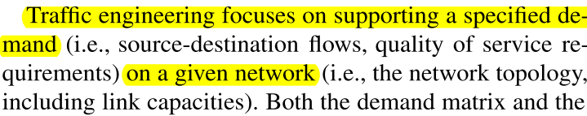
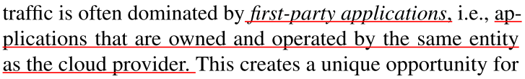
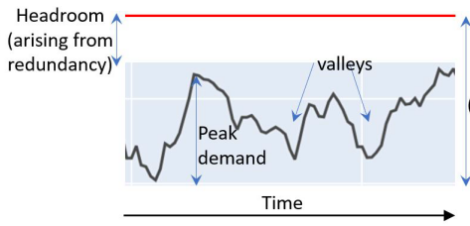
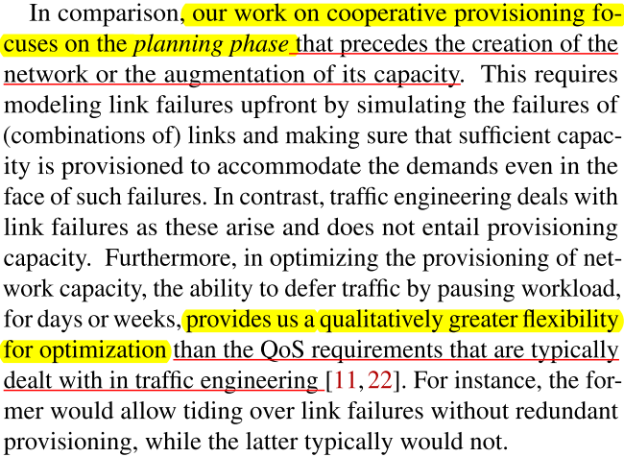
Notes: Optimizing Network Provisioning through Cooperation ^{[1]}
II. Challenges
I. Applications
Provide PERFECT amount of bandwidth for immediate and deferrable applications within desired applications’ deadlines.
Provision Wide-Area Network (WAN) bandwidth capacity in inter-data center (DC) for first-party applications in cloud-scale services.
Figure source: Figure 2 in [1].
Provisioned capacity.
Larger capacity, higher costs.
The headroom and the valleys represent capacity that could be used to accommodate background demand and reduce total provisioned capacity.
[1] https://www.usenix.org/conference/nsdi22/presentation/sharma

Slide 2
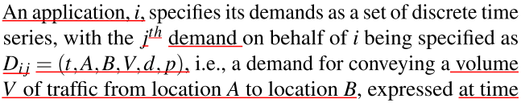
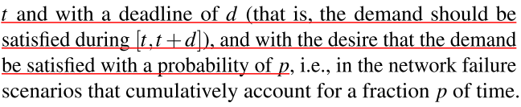
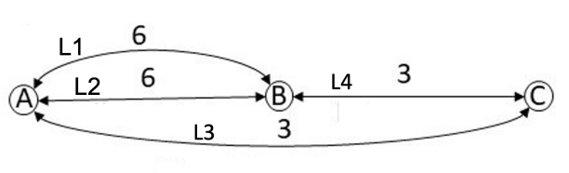
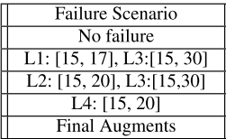

Notes: Optimizing Network Provisioning through Cooperation ^{[1]}
III. Methods
Definitions:
Summary:
Based on knowledge of the application’s deadline coupled with network link failure statistics, the methods optimize network provision by ensuring that application demands are accommodated with the desired satisfaction probability.
D: demand or request, each has a demand satisfaction probability p, and ordered by the value of p:
Example:
Link L1 fails on day 15th and comes back on day 17th.
Sort to increasing order
Each p associates with a set of failure scenarios
If cutoff probability is p2, all the corresponding demands up to p2 will be provisioned.
A, B, and C are nodes representing data centers.
L1-L4 are links with provisioned capacities between centers.
[1] https://www.usenix.org/conference/nsdi22/presentation/sharma

Slide 3
Notes: Optimizing Network Provisioning through Cooperation ^{[1]}
III. Methods
Definitions:
Summary:
Based on knowledge of the application’s deadline coupled with network link failure statistics, the methods optimize network provision by cooperating between application and network, and by ensuring that application demands are accommodated with the desired satisfaction probability.
D: demand or request, each has a demand satisfaction probability p, and ordered by the value of p:
c
Example:
Link L1 fails on day 15th and comes back on day 17th.
Sort to increasing order
Each p associates with a set of failure scenarios
c
If cutoff probability is p2, all the corresponding demands up to p2 will be provisioned.
A, B, and C are nodes representing data centers.
L1-L4 are links with provisioned capacities between centers.
[1] https://www.usenix.org/conference/nsdi22/presentation/sharma

Slide 4
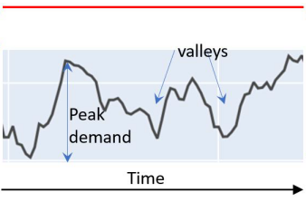
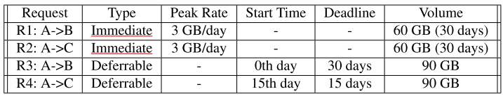
Notes: Optimizing Network Provisioning through Cooperation ^{[1]}
III. Methods
Example: Accommodating capacity for immediate demand with failure scenarios
Baseline method:
Proposed method:
Capacity for Immediate demand
L1 | L2 | L3 | L4
6 | 6 | 3 | 3
L1 | L2 | L3 | L4
6 | 6 | 3 | 3
A, B, and C are nodes representing data centers.
L1-L4 are data links between centers.
[1] https://www.usenix.org/conference/nsdi22/presentation/sharma

Slide 5
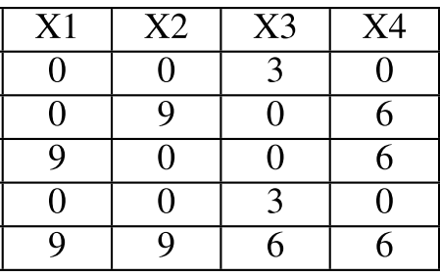
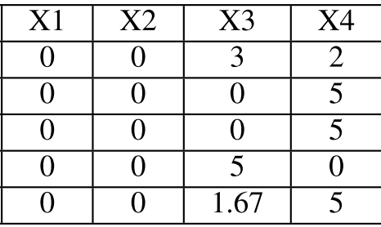
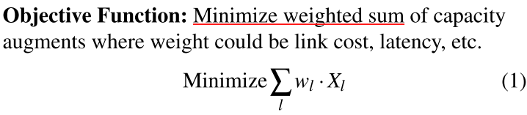
Notes: Optimizing Network Provisioning through Cooperation ^{[1]}
III. Methods
Baseline method:
Proposed method:
Capacity for Immediate demands
L1 | L2 | L3 | L4
6 | 6 | 3 | 3
L1 | L2 | L3 | L4
6 | 6 | 3 | 3
Augmented capacity for deferrable demands, given the failure scenarios of links.
Failure Scenario L1:[15, 17] means: link L1 fails on day 15th and comes back on day 17th.
[1] https://www.usenix.org/conference/nsdi22/presentation/sharma

Slide 6
Notes: Optimizing Network Provisioning through Cooperation ^{[1]}
III. Methods
Summary：
Satisfy the cost function (1) with constraints A, B and C, equations (2) –(5).
Baseline method:
Proposed method:
Capacity for Immediate demands
L1 | L2 | L3 | L4
6 | 6 | 3 | 3
L1 | L2 | L3 | L4
6 | 6 | 3 | 3
Augmented capacity for deferrable demands, given the failure scenarios of links.
Failure Scenario L1:[15, 17] means: link L1 fails on day 15th and comes back on day 17th.
[1] https://www.usenix.org/conference/nsdi22/presentation/sharma

Slide 7
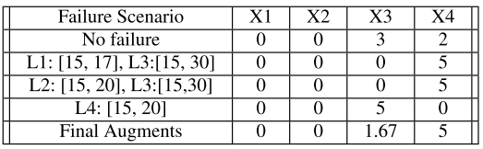
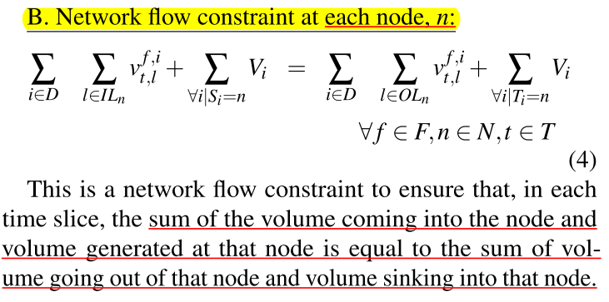
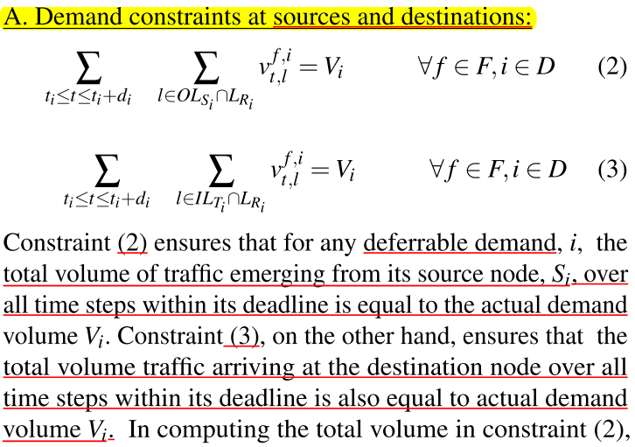
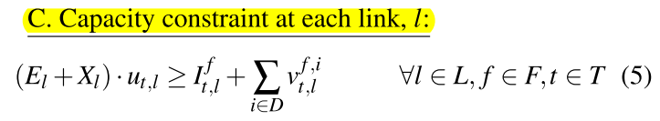
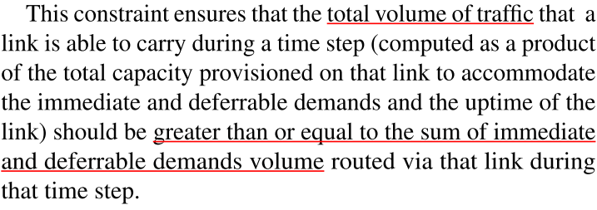
Notes: Optimizing Network Provisioning through Cooperation ^{[1]}
III. Methods
[1] https://www.usenix.org/conference/nsdi22/presentation/sharma

Slide 8
Notes: Optimizing Network Provisioning through Cooperation ^{[1]}
III. Methods
[1] https://www.usenix.org/conference/nsdi22/presentation/sharma

Slide 9
Notes: Optimizing Network Provisioning through Cooperation ^{[1]}
III. Methods
[1] https://www.usenix.org/conference/nsdi22/presentation/sharma

Slide 10
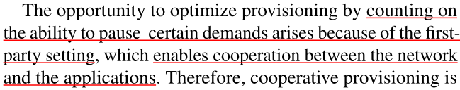
Notes: Optimizing Network Provisioning through Cooperation ^{[1]}
IV. Conclusions
Reduce provisioned network capacity signiﬁcantly, with savings ranging from 30% to 45%, while supporting specific demands, and improving link utilization compared to the baseline.
Remain effective even when used with demand forecasts.
In an example, Baseline provisioning requires 30 GB/day total capacity augments whereas the proposed method Application-informed Provisioning (Approv) requires only 6.67 GB/day total capacity augments.
Baseline method:
Proposed method:
Capacity for Immediate demands
L1 | L2 | L3 | L4
6 | 6 | 3 | 3
L1 | L2 | L3 | L4
6 | 6 | 3 | 3
Augmented capacity for deferrable demands, given the failure scenarios of links.
Total augmented capacity: 30 6.67
Limitations:
[1] https://www.usenix.org/conference/nsdi22/presentation/sharma

